Slide 1
UML DIAGRAM VERSION 2.0 [DRAFT 1]
= ACTOR
= ACTION
LOGOUT
USER
GUI
MODIFICATION
OF
LOCATIONS
LOGIN
ADMIN
GOOGLE EARTH
ROUTE CALCULATIONS
DISPLAY SHORTEST ROUTE

Slide 2

UML DIAGRAM VERSION 2.0
[LOGIN DIAGRAM]
[USER]→
LOGIN
[ADMIN]→
PROMPT FOR USERNAME
PROMPT FOR PASSWORD

Slide 3
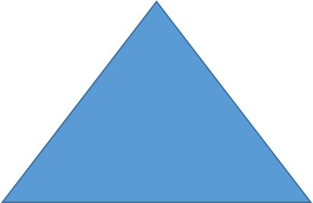
UML DIAGRAM VERSION 2.0
[MODIFICATIONS OF LOCATIONS DIAGRAM]
USER
ADD STARTPOINT LOCATION
ADD
ADD STARTPOINT LOCATION
ADD STARTPOINT LOCATION
CHANGE STARTPOINT LOCATION
EDIT
CHANGE STARTPOINT LOCATION
DELETE STARTPOINT LOCATION
CHANGE STARTPOINT LOCATION
DELETE
DELETE STARTPOINT LOCATION
DELETE STARTPOINT LOCATION
ADMIN

Slide 4
UML DIAGRAM VERSION 2.0
[ROUTE CALCULATIONS]

